Slide 1

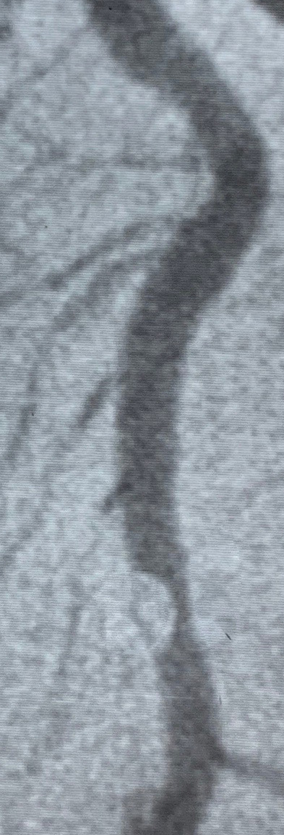
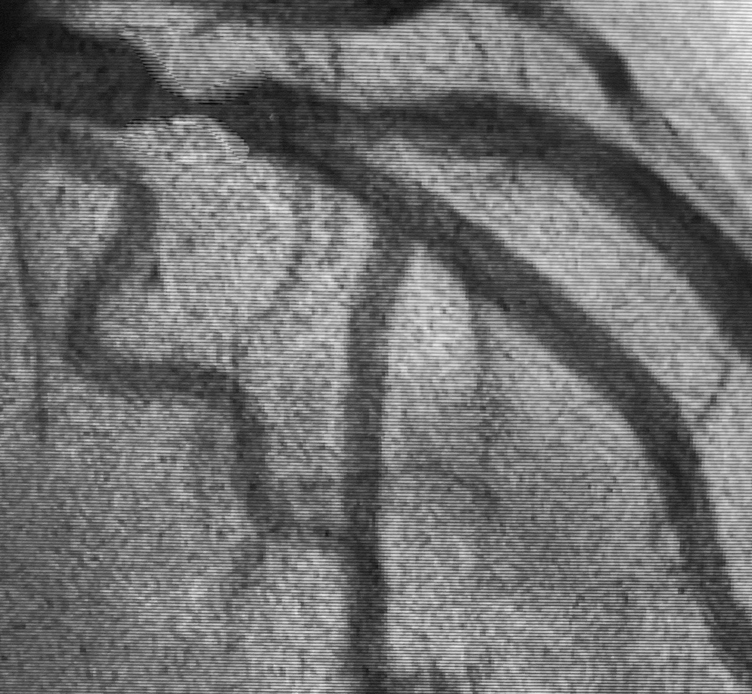
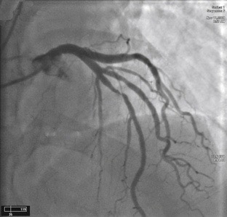
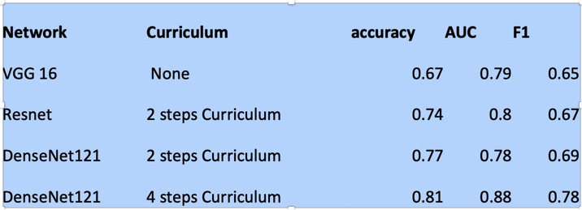

Convolutional Neural Networks For Interpretation Of Coronary Angiography Paul C Lee MD 1, Nathaniel Lee 2, Robert Pyo MD 1
1 Stony Brook Heart Institute, Stony Brook, NY, 2 Computer Science Department, Stanford University, CA.
Financial Disclosures
We performed transfer learning using VGG16, VGG19, ResNet, Densenet, and Inception-ResNet V2 pretrained on ImageNet.
Neural nets were trained on NVIDIA RTX 2080 Ti x 4 GPUs with NVLink standard hyperparameter optimization technique.
Stenosis:
Conventional ConvNet: at best we could only achieve 65% test set accuracy with DenseNet121:
Curriculum training: instead of learning a big set of data in one shot, we created a curriculum of 4 sets of data, starting with dataset with simple lesions (“what is stenosis?”), and then gradually increase complexity (“stenosis in context”.) Test accuracy increased to 81%.
Application
None.
We incorporated the best performing DenseNet121 neural networks into an iPhone app (see video):
.
Background
Management of complex coronary artery disease requires accurate assessment of coronary angiogram by catheterization. However, SYNTAX score interobserver variability is high. Convolutional neural networks have revolutionized computer vision.
Objective
Can Convolutional Neural Networks (CNN) can be used to interpret coronary angiograms?
DenseNet Convolutional Neural Network Architecture
Summary
Anatomy: Both DenseNet121 and VGG16 with ImageNet pre-trained weights provided high level of accuracy for anatomy, using conventional technique (accuracy for test set= 86% for both.)
Start
Curriculum
Training
Neural Net
Finished
Training
Methods and Material
References
Coronary angiogram images were obtained via web crawling of PCI cases, journals, and textbooks to protect patient privacy and to rapidly maximize training data. Each example was labelled for binary classification of stenosis (defined by the presence of clinically significant coronary stenosis), and for multiclass classification of anatomy (RCA, LAD, LCx, or left main, based on prominent artery).
The final dataset: 4980 figures, with 3390, 1450, and 140 as train/validation/test split.
Level 1:
Focal lesion
Level 2:
Single vessel
Level 3:
Bifurcation and overlaps
Level 4:
Whole picture
Gao Huang et al. (2017) Densely Connected Convolutional Networks. arXiv:1608.06993
Guy Hacohen, Daphna Weinshall. (2019) On The Power of Curriculum Learning in Training Deep Networks. arXiv:1904.03626
Adrian Rosebrock (2019) Keras learning rate schedules and decay. https://www.pyimagesearch.com/2019/07/22/keras-learning-rate-schedules-and-decay/
Kazuaki Mitsudo. (2016) PCI technique of Professor Mitsudo (in Japanese). (光藤 和明. 術者MITSUDOの押さないPCI.)
Special thanks to Dr. Annapoorna Kini (Director of Cath Lab, Mount Sinai Hospital, NY) for her permission to use her videos for demonstration. This work is indebted to the works of Japanese interventional cardiologists. And I thank Dr. Adrian Rosebrock of PyImageSearch for his numerous technical tips on computer vision.

